Slide 1
UNIT - I
PHYSICAL LAYER

Slide 2
UNIT – I
Physical Layer – Fourier Analysis – Bandwidth Limited Signals – The Maximum Data Rate of a Channel Guided Transmission Media, Multiplexing: Frequency Division Multiplexing, Time Division Multiplexing, Code Division Multiplexing.

Slide 3
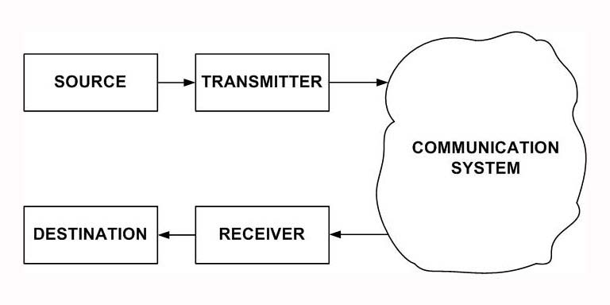
SIMPLIFIED MODEL OF A DATA COMMUNICATION SYSTEM

Slide 4
DATA
Any information that conveys some meaning Data can be of two types
Analog
Digital
Analog data take on continuous values on some interval
Examples of analog data:
Voice
Video
Data that are collected from the real world with the help of transducers are continuous-valued or analog in nature.
On the contrary, digital data take on discrete values. Text or character strings can be considered as examples of digital data. Characters are represented by suitable codes, e.g. ASCII code, where each character is represented by a 7-bit code

Slide 5
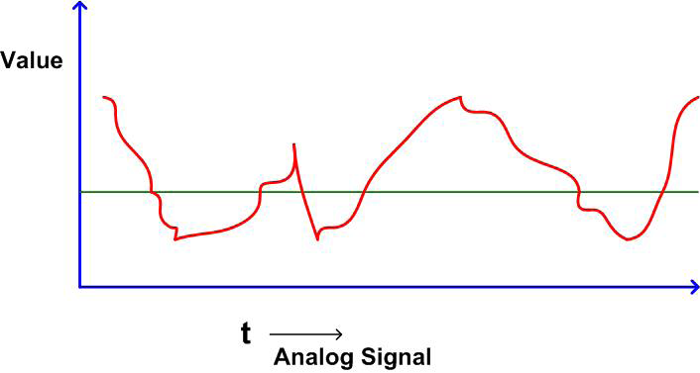
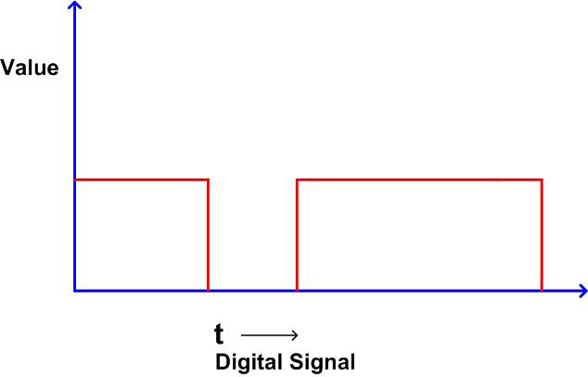
SIGNAL
It is electrical, electronic or optical representation of data, which can be sent over a communication medium

Slide 6


FOURIER ANALYSIS
A Periodic signal g(t) with a period T can be constructed as the sum of a number of sines and cosines
where f = 1/T is the fundamental frequency, a_{n,} and b_{n} are the sine and cosine amplitudes of nth harmonics and c is a constant
This decomposition is called Fourier Transform
a_{n} amplitude can be computed for any given g(t) by multiplying both sides of above equation by sin(2πkft) and then integrating from 0 to T. Since

Slide 7

FOURIER ANALYSIS cntd..
Only one term of the summation survives: a_{n}. The b_{n} summation vanishes completely.
Similarly, by multiplying above Equation by cos(2πkft) and integrating between 0 and T, we can derive b_{n}
By just integrating both sides of the equation as it stands, we can find c. The results of performing these operations are as follows:

Slide 8
MAX DATA RATE OF A CHANNEL
NYQUIST BIT RATE
The maximum rate at which data can be correctly communicated over a channel in presence of noise and distortion is known as its channel capacity
Consider first a noise free channel of Bandwidth B. Based on Nyquist formulation it is known that given a bandwidth B of a channel, the maximum data rate that can be carried is 2B. This limitation arises due to the effect of inter symbol interference caused by the frequency components higher than B
If the signal consists of m discrete levels, then Nyquist theorem states
C – Channel Capacity
B – Bandwidth of the Channel
m – No of signal levels used

Slide 9
SHANNON CHANNEL CAPACITY
In presence of Gaussian band-limited white noise, Shannon-Hartley theorem gives the maximum data rate capacity
C = B log₂ (1 + S/N)
where S and N are the signal and noise power, respectively, at the output of the channel.
This theorem gives an upper bound of the data rate which can be reliably transmitted over a thermal-noise limited channel

Slide 10
EXAMPLE PROBLEM
Suppose we have a channel of 3000 Hz bandwidth, we need an S/N ratio (i.e. signal to noise ration, SNR) of 30 dB to have an acceptable bit-error rate. What is the maximum data rate that we can transmit?

Slide 11
ANSWER
We have, from Shannon-Hartley Theorem
C = B log₂ (1 + S/N)
S/N = 30 Db
B = 3000 Hz
Therefore, the maximum data rate that we can transmit 30,000 bps
FOR SELF EVALUATION
The digital signal is to be designed to permit 160kbps for a bandwidth of 20KHz.
Determine (a) number of levels (m)and (b) S/N ratio.

Slide 12
OBSERVATIONS
In practice, because of the presence of different types of noises, attenuation and delay distortions, actual (practical) upper limit will be much lower.
In case of extremely noisy channel, C = 0
Between the Nyquist Bit Rate and the Shannon limit, the result providing the smallest channel capacity is the one that establishes the limit

Slide 13
BIT RATE & BAUD RATE
BAUD RATE
The baud rate or signaling rate is defined as the number of distinct symbols transmitted per second, irrespective of the form of encoding.
For baseband digital transmission m = 2. So, the maximum baud rate = 1/Element width (in Seconds) = 2B
BIT RATE
The bit rate or information rate I is the actual equivalent number of bits transmitted per second.
I = Baud Rate x Bits per Baud

Slide 14
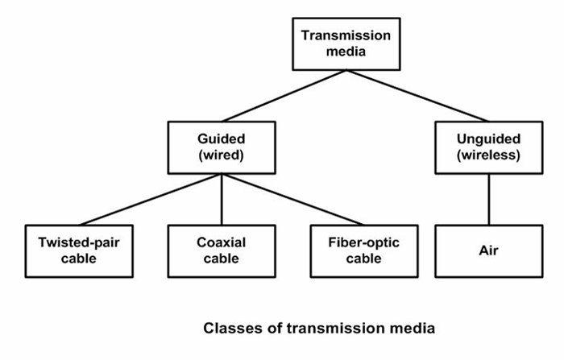
CLASSIFICATION OF TRANSMISSION MEDIA
Guided − In guided media, transmitted data travels through cabling system that has a fixed path. For example, copper wires, fibre optic wires, etc.
.
Unguided − In unguided media, transmitted data travels through free space in form of electromagnetic signal. For example, radio waves, lasers, etc

Slide 15
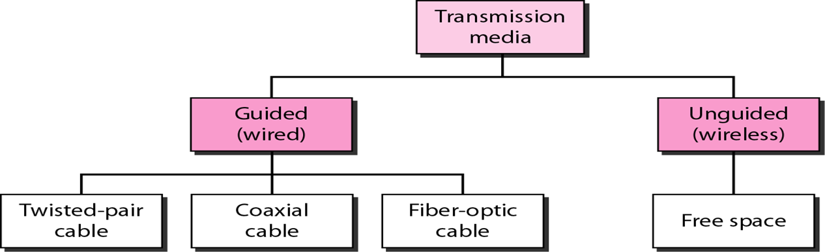
CLASSIFICATION OF TRANSMISSION MEDIA

Slide 16
TWISTED - PAIR CABLE
Copper wires are the most common wires used for transmitting signals because of good performance at low costs.
In twisted pair technology, two copper wires are twisted between two point
The two wires are typically “twisted” together in a helix to reduce interference between the two conductors
Typically, a number of pairs are bundled together into a cable by wrapping them in a tough protective sheath
Twisted pair cable are the oldest and most popular cables all over the world.

Slide 17


TWISTED - PAIR CABLE
Data rate determined by wire thickness and length. In addition, shielding to eliminate interference from other wires impacts signal-to-noise ratio, and ultimately, the data rate

Slide 19
Unshielded Twisted Pair
The wires that are not shielded but simply bundled together in a protective sheath are called unshielded twisted pair (UTP) cables.
These cables can have maximum length of 100 meters.
It is used for telephonic applications.

Slide 20
Categories of the unshielded twisted pair cable:
Category 1: Category 1 is used for telephone lines that have low-speed data.
Category 2: It can support upto 4Mbps.
Category 3: It can support upto 16Mbps.
Category 4: It can support upto 20Mbps. Therefore, it can be used for long-distance communication.
Category 5: It can support upto 200Mbps.

Slide 21
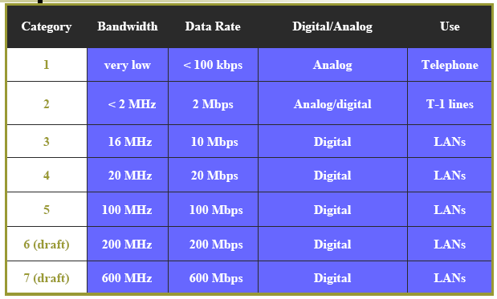
UTP Categories

Slide 22


TWISTED - PAIR CABLE cntd….
(a) Category 3 UTP (b) Category 5 UTP
UTP – Unshielded Twisted Pair

Slide 23
Advantages Of Unshielded Twisted Pair:
It is cheap.
Installation of the unshielded twisted pair is easy.
It can be used for high-speed LAN.
Disadvantage:
This cable can only be used for shorter distances because of attenuation.
Susceptible to external interference
Lower capacity and performance in comparison to STP

Slide 24
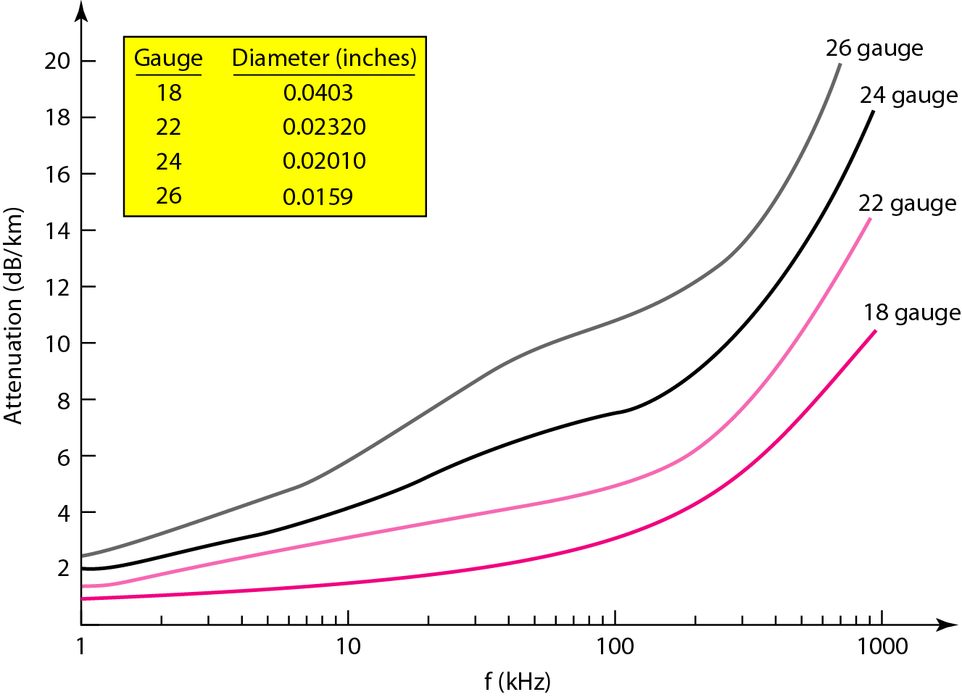
UTP Performance

Slide 25
Shielded Twisted Pair
A shielded twisted pair is a cable that contains the mesh surrounding the wire that allows the higher transmission rate.
This type of cable consists of a special jacket (a copper braid covering or a foil shield) to block external interference.
It is used in fast-data-rate Ethernet and in voice and data channels of telephone lines.

Slide 26
Advantages:
Better performance at a higher data rate in comparison to UTP
Eliminates crosstalk
Comparatively faster
Disadvantages:
Comparatively difficult to install and manufacture
More expensive
Bulky

Slide 27
TWISTED - PAIR CABLE cntd….
Data rates of several Mbps
Spans distances of several kilometers
Data rate determined by wire thickness and length. In addition, shielding to eliminate interference from other wires impacts signal-to-noise ratio, and ultimately, the data rate
Good, low-cost communication
USE
The oldest and the most popular use of twisted pair are in telephony.
In LAN it is commonly used for point-to-point short distance communication (say, 100m) within a building or a room

Slide 28
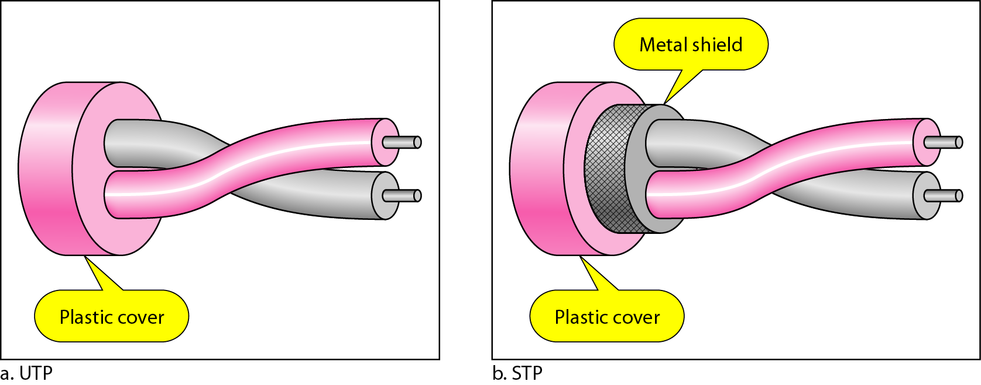
UTP and STP cables

Slide 29
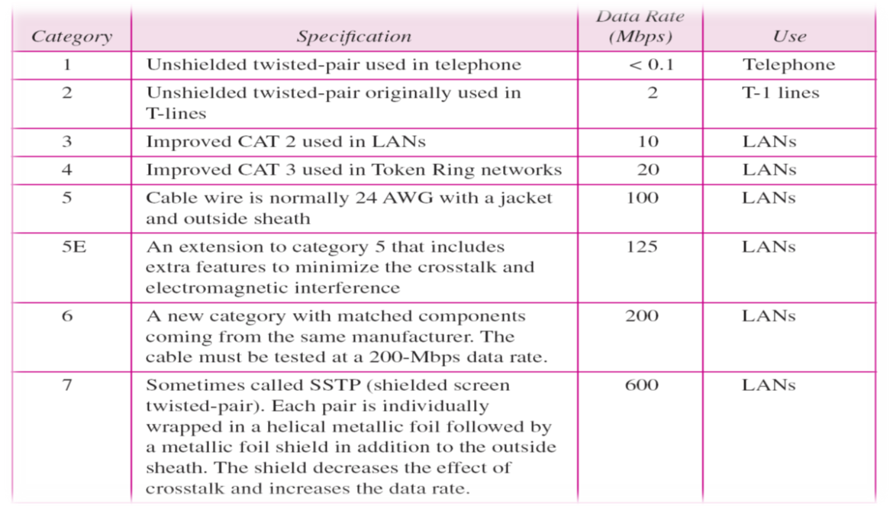
Categories of unshielded twisted-pair cables

Slide 30
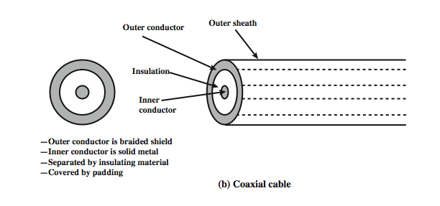
COAXIAL CABLE
Coaxial cables are copper cables with better shielding than twisted pair cables, so that transmitted signals may travel longer distances at higher speeds.
With ``coax'', the medium consists of a copper core surrounded by insulating material and a braided outer conductor

Slide 31
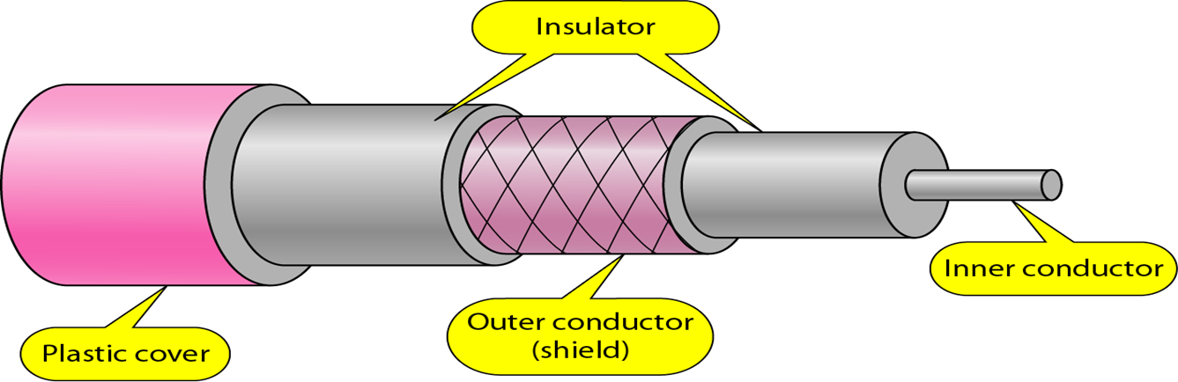
COAXIAL CABLE
It has an outer plastic covering containing an insulation layer made of PVC or Teflon and 2 parallel conductors each having a separate insulated protection cover.
The name of the cable is coaxial as it contains two conductors parallel to each other.
The inner conductor of the coaxial cable is made up of copper, and the outer conductor is made up of copper mesh. The middle core is made up of non-conductive cover that separates the inner conductor from the outer conductor.

Slide 32
COAXIAL CABLE cntd..
The middle core is responsible for the data transferring whereas the copper mesh prevents from the EMI(Electromagnetic interference).
Co-axial cable has superior frequency characteristics compared to twisted-pair and can be used for both analog and digital signaling.
The coaxial cable transmits information in two modes: Baseband mode(dedicated cable bandwidth) and Broadband mode(cable bandwidth is split into separate ranges).
Baseband transmission: It is defined as the process of transmitting a single signal at high speed.
Broadband transmission: It is defined as the process of transmitting multiple signals simultaneously.

Slide 33
COAXIAL CABLE cntd..
In baseband LAN, the data rates lies in the range of 1 KHz to 20 MHz over a distance in the range of 1 Km.
Coaxial cables typically have a diameter of 3/8 mm. Coaxial cables are used both for baseband and broadband communication.
For broadband CATV application coaxial cable of ½ mm diameter and 75 Ω impedance is used. This cable offers bandwidths of 300 to 400 MHz facilitating high-speed data communication with low bit-error rate.

Slide 34
Advantages:
High Bandwidth
Better noise Immunity
Easy to install and expand
Inexpensive
Can be used for both analog and digital signals
Disadvantages:
Single cable failure can disrupt the entire network
It is more expensive as compared to twisted pair cable.

Slide 35
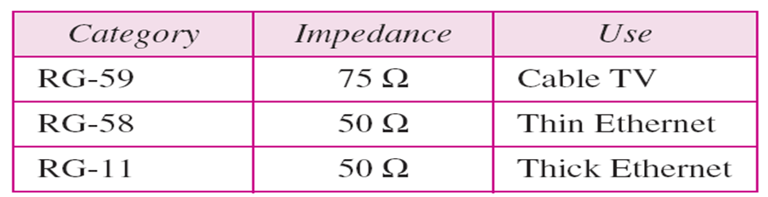
Categories of coaxial cables

Slide 36
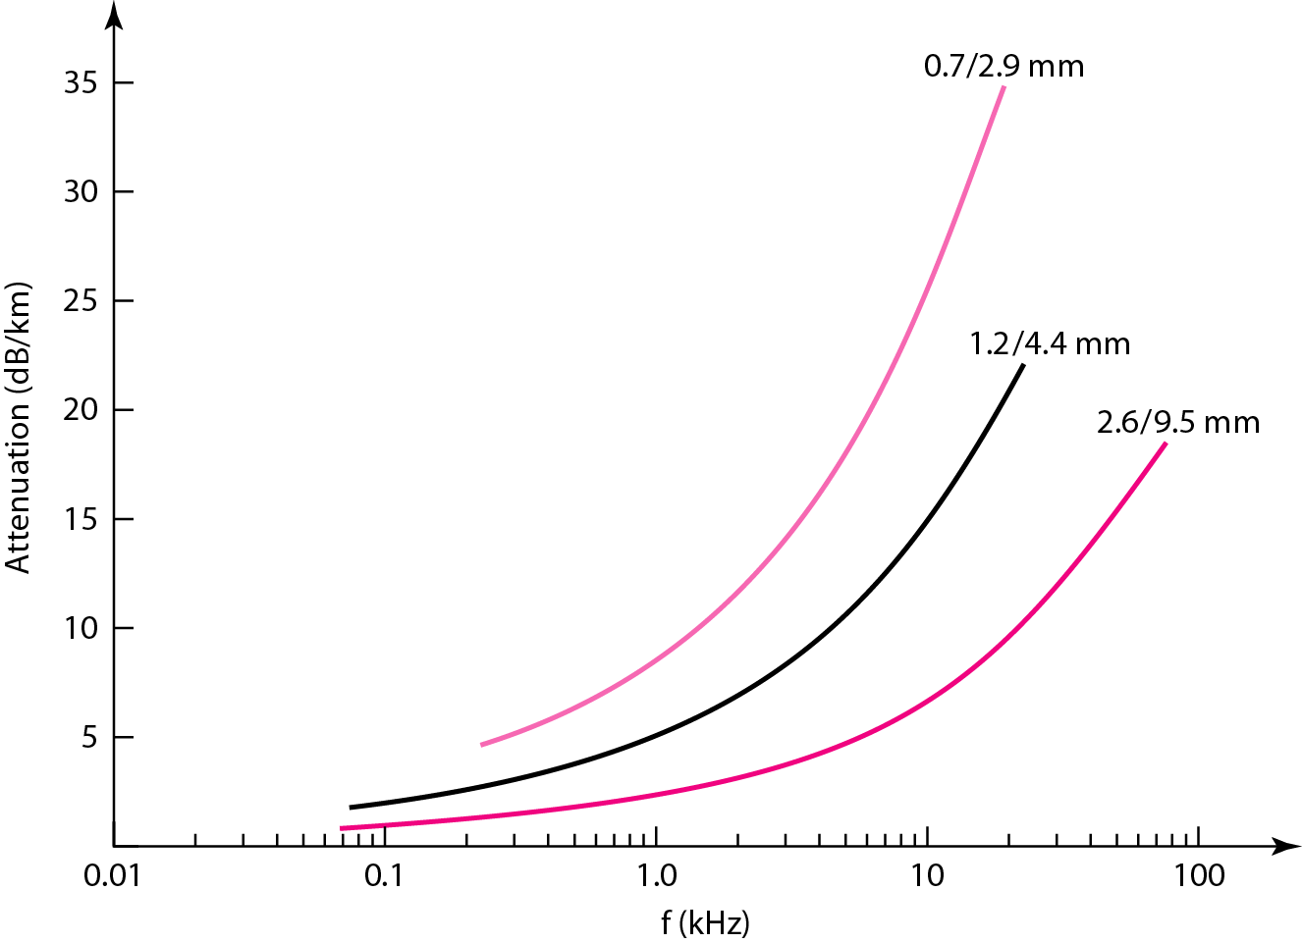
Coaxial Cable Performance

Slide 37
FIBER OPTIC CABLE
Fibre optic cable is a cable that uses electrical signals for communication.
Fibre optic is a cable that holds the optical fibres coated in plastic that are used to send the data by pulses of light.
The plastic coating protects the optical fibres from heat, cold, electromagnetic interference from other types of wiring.
Fibre optics provide faster data transmission than copper wires.
Based on the principle of refraction and reflection of light.
It is used for the transmission of large volumes of data.

Slide 38
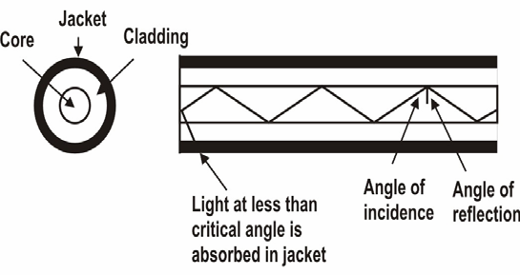
In fiber optic technology, the medium consists of a hair-width strand of silicon or glass, and the signal consists of pulses of light
a pulse of light means “1”
lack of pulse means ``0''.
It has a cylindrical shape and consists of three concentric sections: the core, the cladding, and the jacket as shown below
Core made of high quality silica glass or plastic
Cladding made of high quality silica glass or plastic, with a lower refractive index than the core
Protective outer covering called Jacket

Slide 39
FIBER OPTIC CABLE cntd..
The core, innermost section consists of a single solid dielectric cylinder of diameter d₁ and of refractive index n₁
As a consequence, the light is propagated through multiple total internal reflection
The core material is usually made of ultra pure fused silica or glass
The cladding is either made of glass or plastic
The cladding is surrounded by a jacket made of plastic which is used to protect against moisture, abrasion, crushing and other environmental hazards

Slide 40
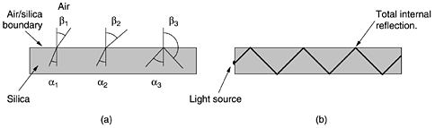
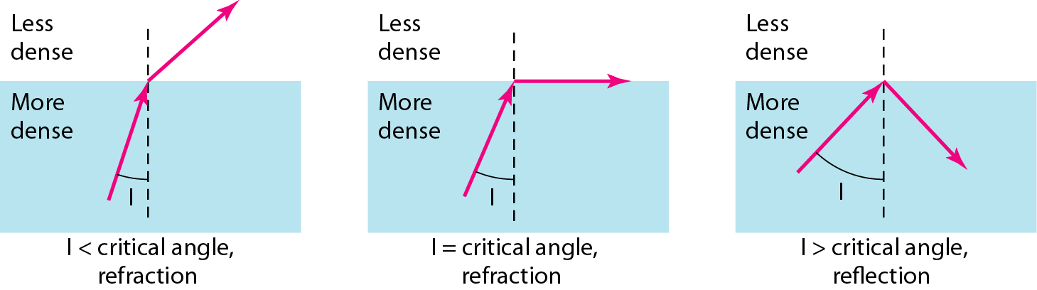
OPERATING PRINCIPLE OF OPTICAL FIBER

Slide 41
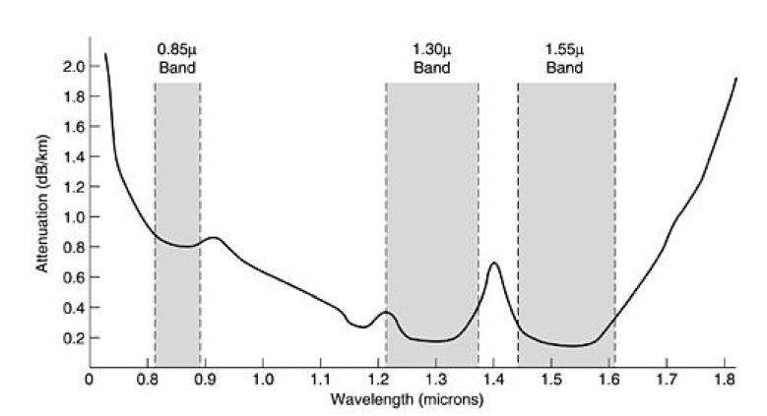

ATTENUATION OF LIGHT THROUGH FIBER IN THE INFRARED REGION

Slide 42
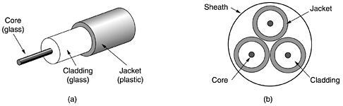
VIEW OF OPTICAL FIBER
(a) Side view of a single fiber (b) End view of a sheath with three fibers
THREE COMPONENTS ARE REQUIRED
Fiber medium: Current technology carries light pulses for tremendous distances (e.g., 100s of kilometers) with virtually no signal loss
2. Light source: typically a Light Emitting Diode (LED) or laser diode. Running current through the material generates a pulse of light
3. A photo diode light detector, which converts light pulses into electrical signals.

Slide 43
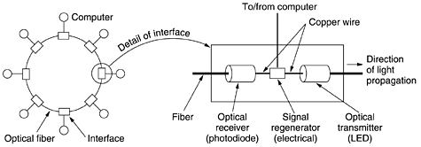
A FIBER OPTIC RING WITH ACTIVE REPEATERS

Slide 44
CHARACTERISTICS OF OPTICAL FIBER cntd…
In a multi-mode fiber, the quality of signal-encoded light deteriorates more rapidly than single-mode fiber, because of interference of many light rays.
As a consequence, single mode fiber allows longer distances without repeater
For multi-mode fiber, the typical maximum length of the cable without a repeater is 2km, whereas for single-mode fiber it is 20km
44
44

Slide 45
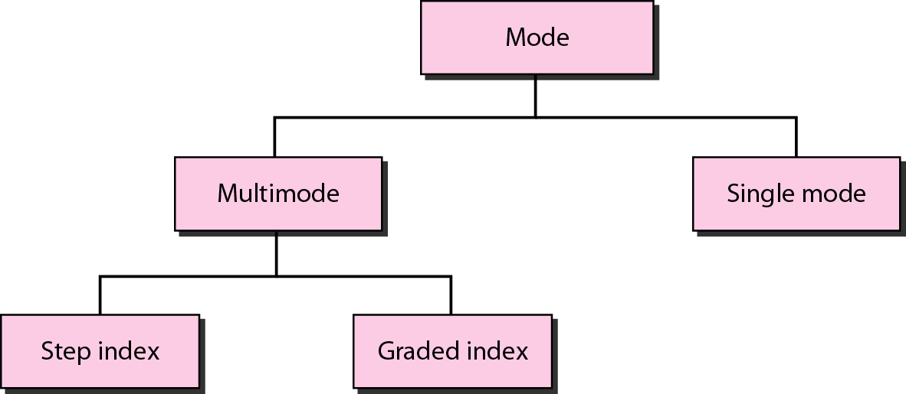
Propagation Modes

Slide 46
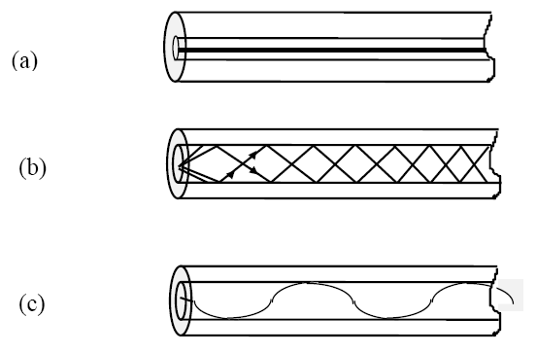
MODES OF OPERATION OF OPTICAL FIBER
Schematic of three optical fiber types (a) Single-mode step-index
(b) Multi-mode Step-index
(c) Multi-mode graded-index

Slide 47
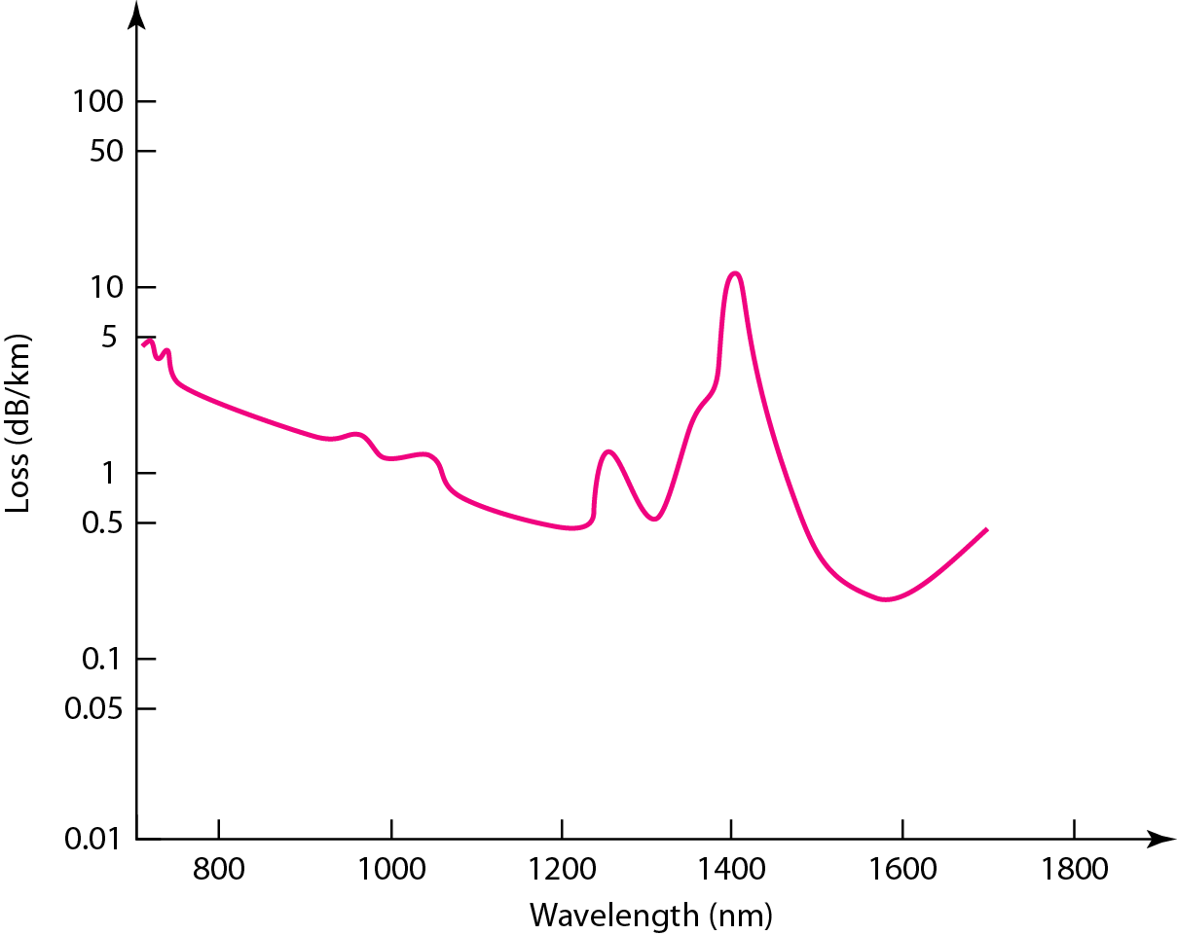
Performance

Slide 48
ADVANTAGES OF OPTICAL FIBER
Greater Speed :Very high data rate 1000 Mbps (1 Gbps) over distances of kilometers since data is carried in the form of light
Error rates are so low they are almost negligible
Not susceptible to electrical interference lightning or corrosion (rust)
Greater Bandwidth: The fibre optic cable provides more bandwidth as compared copper. Therefore, the fibre optic carries more data as compared to copper cable.
Light Weight
Longer distances: The fibre optic cable carries the data at a longer distance as compared to copper cable.
Better reliability: The fibre optic cable is more reliable than the copper cable as it is immune to any temperature changes while it can cause obstruct in the connectivity of copper cable. And it is difficult to tap.
Less signal attenuation

Slide 49
DISADVANTAGES OF OPTICAL FIBER
Difficult to tap. It is most suitable for point-to-point technology
One-way channel. Two fibers needed to get full duplex (both ways) communication.
Difficult to install and maintain - Sophisticated technology required for manufacturing, installing and maintaining optical fibre cables
High cost
Fragile

Slide 50
Applications
Because of greater bandwidth (2Gbps), smaller diameter, lighter weight, low attenuation, immunity to electromagnetic interference and longer repeater spacing, optical fiber cables are finding widespread use in long-distance telecommunications
Long-haul trunks-increasingly common in telephone network (Sprint ads)
Metropolitan trunks-without repeaters (average 8 miles in length)
Rural exchange trunks-link towns and villages
Local loops-direct from central exchange to a subscriber (business or home)
Local area networks-100Mbps ring networks

Slide 51
Medical Purpose: Used in several types of medical instruments.
Defence Purpose: Used in transmission of data in aerospace.
For Communication: This is largely used in formation of internet cables.
Industrial Purpose: Used for lighting purposes and safety measures in designing the interior and exterior of automobiles.

Slide 52
Frequency Utilization for Fiber Applications

Slide 53
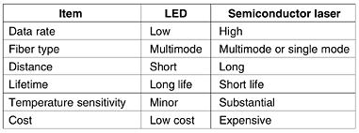
LED vs SEMICONDUCTOR LASER

Slide 54
Transmission Characteristics of Guided Media
Frequency Range
Typical Attenuation
Typical Delay
Repeater Spacing
Twisted pair (with loading)
0 to 3.5 kHz
0.2 dB/km @ 1 kHz
50 µs/km
2 km
Twisted pairs (multi-pair cables)
0 to 1 MHz
0.7 dB/km @ 1 kHz
5 µs/km
2 km
Coaxial cable
0 to 500 MHz
7 dB/km @ 10 MHz
4 µs/km
1 to 9 km
Optical fiber
186 to 370 THz
0.2 to 0.5 dB/km
5 µs/km
40 km

Slide 55
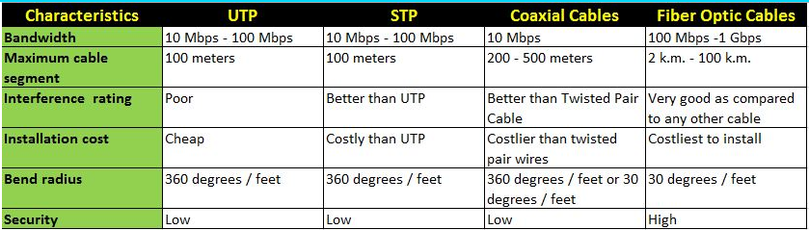
Comparison

Slide 56
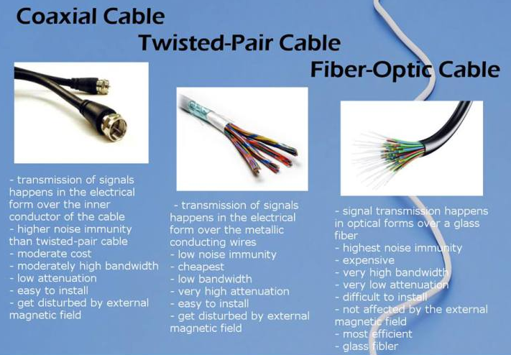

Slide 57
UNGUIDED TRANSMISSION
Unguided transmission is used when running a physical cable (either fiber or copper) between two end points is not possible. For example, running wires between buildings is probably not legal if the building is separated by a public street
Infrared signals typically used for short distances (across the street or within same room)
Microwave signals commonly used for longer distances (10's of km)
Sender and receiver use some sort of dish antenna
57

Slide 58
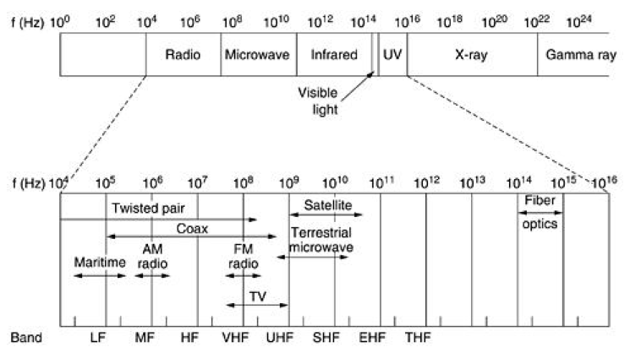
ELECTROMAGNETIC SPECTRUM

Slide 59
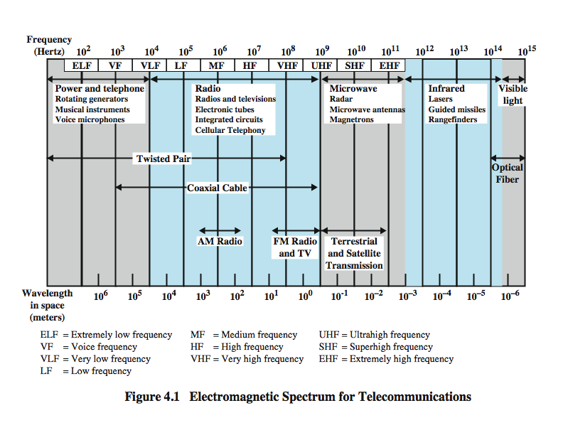
ELECTROMAGNETIC SPECTRUM

Slide 60
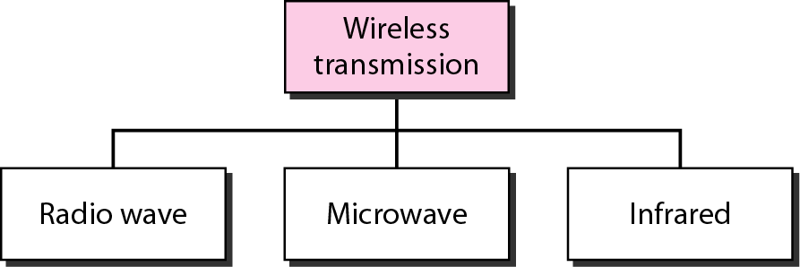
Wireless Transmission Waves

Slide 61
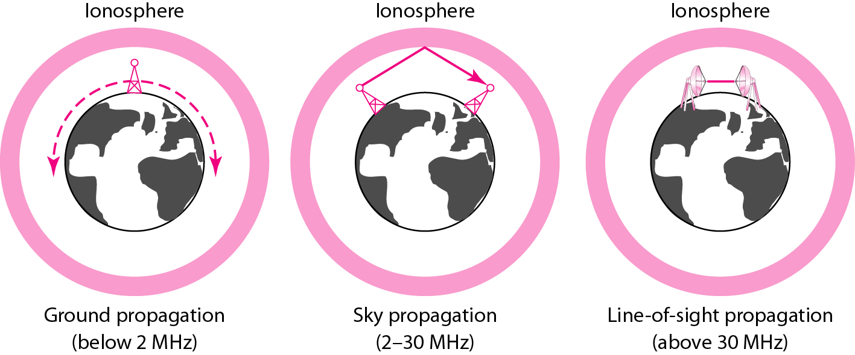
Propagation Methods

Slide 62
Frequency Bands

Slide 63
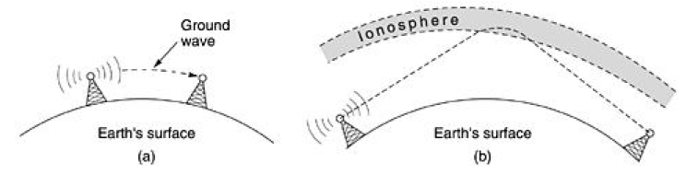
RADIO WAVE TRANSMISSION
In the HF and VHF bands, the ground waves tend to be absorbed by the earth.
The waves that reach the ionosphere, a layer of charged particles circling the earth at a height of 100 to 500 km, are refracted by it and sent back to earth, as shown in (b).
Under certain atmospheric conditions, the signals can bounce several times. Amateur radio operators (hams) use these bands to talk long distance. The military also communicate in the HF and VHF bands

Slide 64
BROADCAST RADIO
FREQUENCY 3kHz to 300GHz
use broadcast radio, 30MHz - 1GHz, for:
FM radio
UHF and VHF television
Omnidirectional
suffers from multipath interference
reflections from land, water, other objects

Slide 65
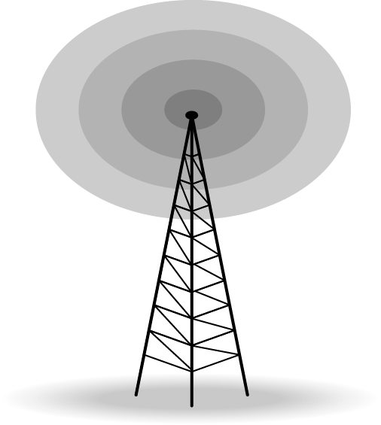
Omnidirectional Antenna
Frequencies between 3 KHz and 1 GHz.
used for multicasts communications, such as radio and television, and paging system.

Slide 66
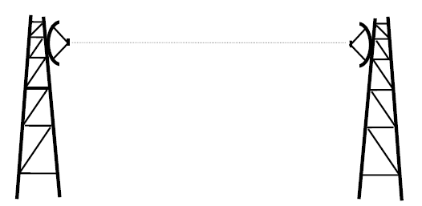
TERRESTRIAL MICROWAVE COMMUNICATION
Difficulties:
Weather interferes with signals (Clouds, rain, lightning, etc) may adversely affect communication
2. Radio transmissions easy to tap
3. Signals bouncing off of structures may lead to out-of-phase signals that the receiver must filter out.
66
66

Slide 67
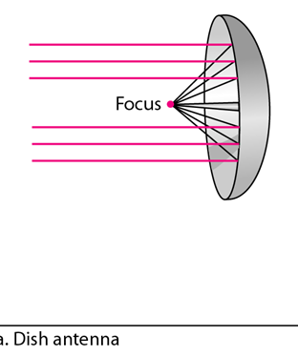
Microwaves
Used for long haul telecommunications and short point-to-point links
Requires fewer repeaters but line of sight
Use a parabolic dish to focus a narrow beam onto a receiver antenna
1-40 GHz frequencies
Higher frequencies give
higher data rates
Main source of loss is
attenuation
distance, rainfall
Interference

Slide 68
Satellite Microwaves
Satellite is relay station
Receives on one frequency, amplifies or repeats signal and transmits on another frequency
eg. uplink 5.925-6.425 GHz & downlink 3.7-4.2 GHz
Typically requires geo-stationary orbit
height of 35,784km
spaced at least 3-4° apart
Typical uses
Television
Long distance telephone
Private business networks
Global positioning

Slide 69
Infrared waves
Frequencies between 300 GHz to 400 THz.
Can not penetrate walls.
Used for short-range communication in a closed area using line-of-sight propagation.

Slide 70
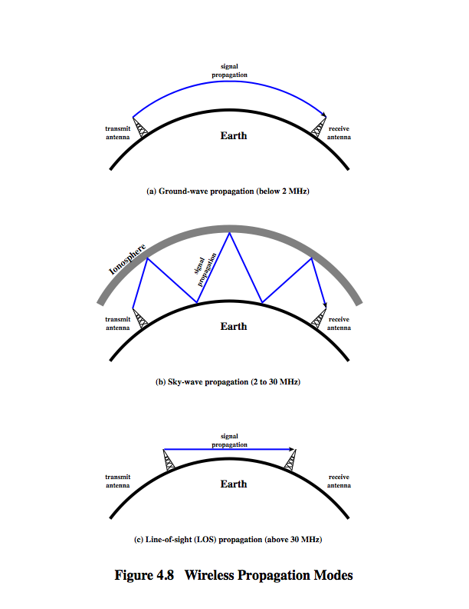
Sky wave and Space wave Propagation

